Slide 1
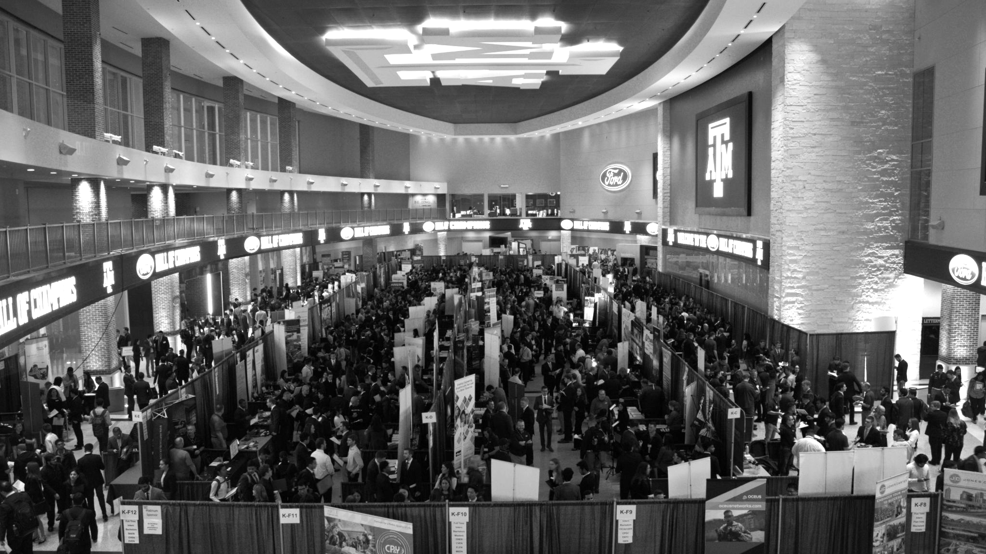

LANL Team Week 2 Project Update
1/22/2025
Izzy Baumler, Dalton Boeckmann, Morgan Gullo, Jade Waldron

Slide 2
Problem Statement/Project Motivation
There is a need for a technology that has 6 DOF and can move through its full range of motion in each degree of freedom of at least 1 Hz.

Slide 3
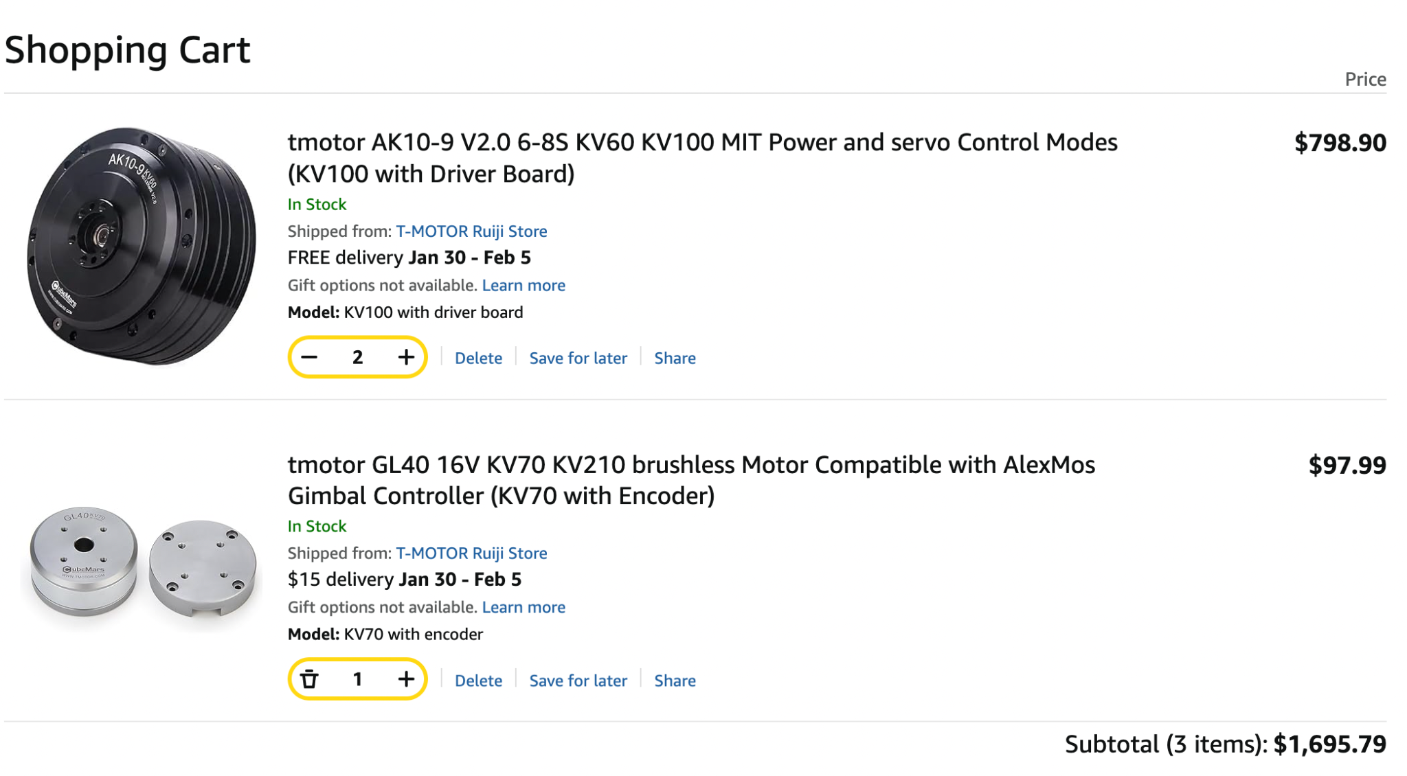
Orders Purchased
Estimated delivery date: January 30th - February 5th

Slide 4
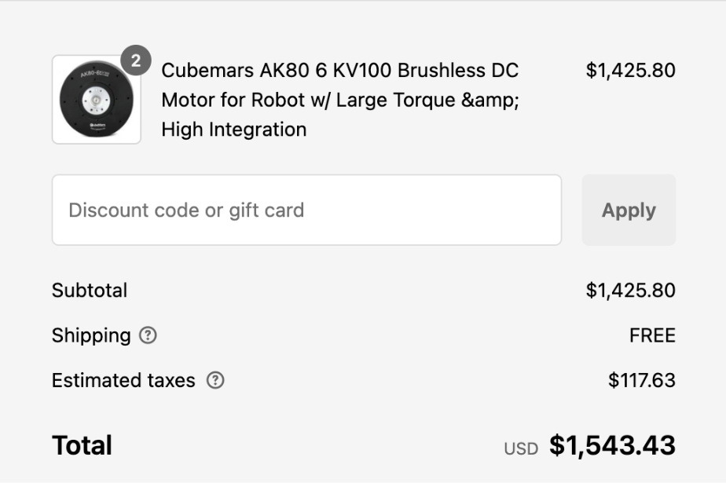
Pending Orders
Experienced issues with original vendor (Cubemars) due to Paypal being the only payment type
Needed to order motor for J3 and J4 from RobotShop due to increased price seen from Amazon
Increased total price of motors by $286 rather than $740

Slide 5
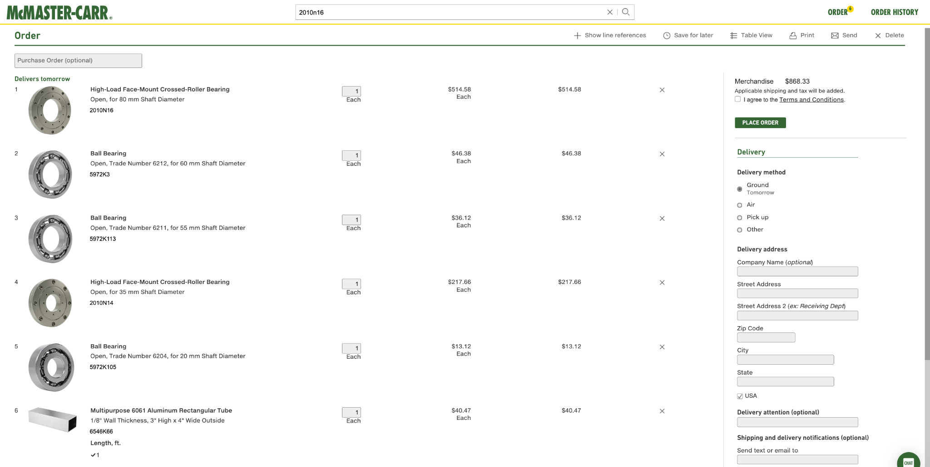
Pending Orders

Slide 6
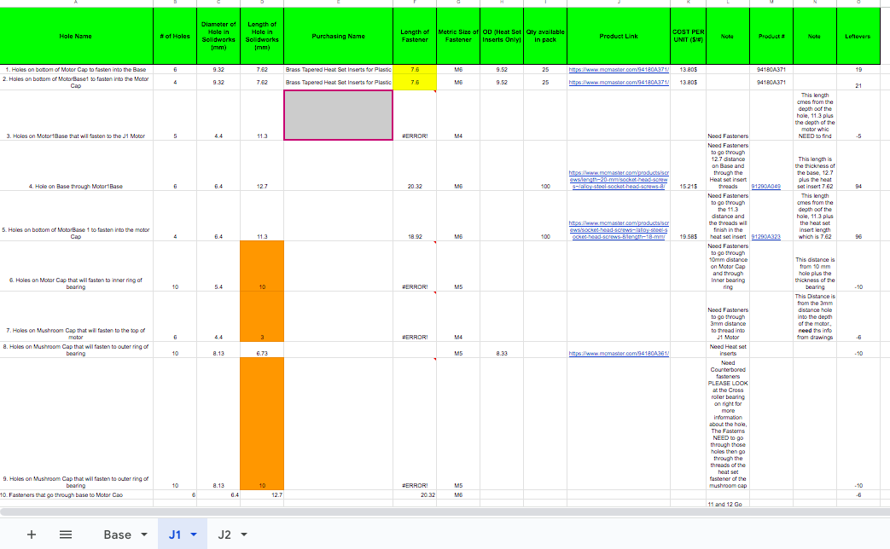
Fasteners
Partner with CAD team to finalize fastener selection
Ensure Assembly ready designs
Cost Reduction Initiatives
Refine CAD Parts to reduce fastener quantity
Optimize fastener choices for cost-effectiveness

Slide 7
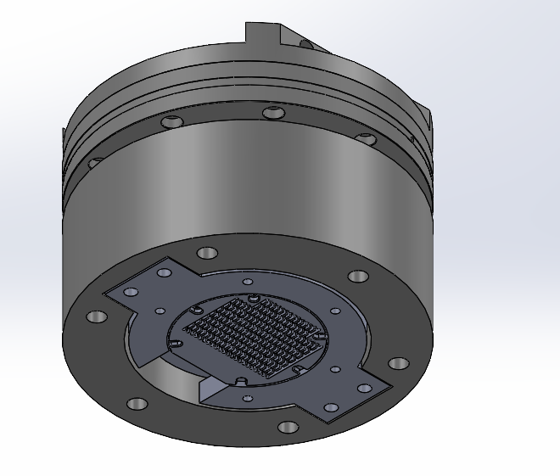
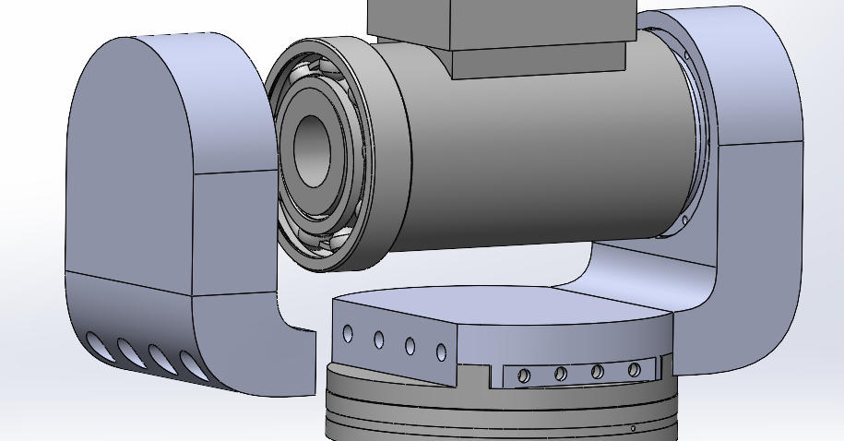
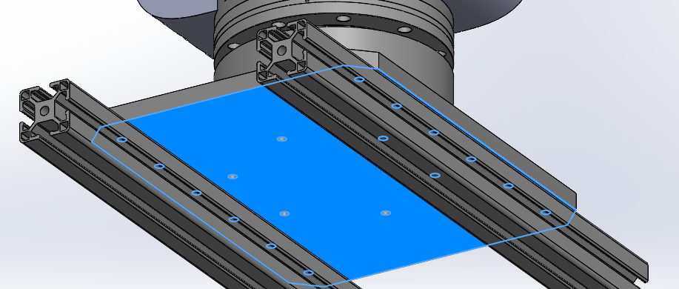
CAD Refinement

Slide 8
Electrical Meeting
Key Considerations and Recommendations
- Add 50% buffer to power requirements
- Break system into multiple parts for power supply
- Determine exact current and voltage requirements
- Implement filtering and isolation for noise reduction
- Consider regulators for large voltage jumps
- Ensure safety switch can handle high current/voltage
- Use AC to DC blocks instead of power distribution board
- Explore TI.com for robotics application insights
Electrical Block Diagram
AC to DC Power Convertor
Electrical Motor (Max & Min Power Requirements)
Computer Processor
Safety Switch
Filtering and Isolation Components
TI Electrical Engineer Meeting - John Varghese - Previous Robotics Experience

Slide 9
Electrical Meeting - Action Plan
1. Determine exact motor specifications (voltage, current, power)
2. Create detailed block diagram with min/max voltage and current for each component
3. Design power supply based on component requirements
4. Select appropriate safety switch and determine implementation method
5. Research and select filtering/isolation components
6. Investigate cost targets and lead times for all components
Remember to optimize power supply selection by working backwards from component requirements and consider breaking the system into multiple power supplies if needed.
TI Electrical Engineer Meeting - John Varghese Previous Robotics Experience

Slide 10
Future Assignments
Continue Selection Process with Fasteners and Ordering
Create electrical box model and get approved by Professional
Order electrical components

